Slide 1

Ajax + axios
Web Programming

Slide 2
Today’s topics
AJAX
What is AJAX
Fetch API
Server-side rendering vs Client-side rendering
Axios
Consuming REST APIs
Linking front-end with back-end
Vue CLI
Vue Router
Let’s update the “youblog” website

Slide 3
What is AJAX?
AJAX = Asynchronous JavaScript And XML.
AJAX is not a programming language.
AJAX just uses a combination of:
A browser built-in XMLHttpRequest object (to request data from a web server)
JavaScript and HTML DOM (to display or use the data)

Slide 4
AJAX
AJAX is a developer's dream, because you can:
Read data from a web server - after the page has loaded
Update a web page without reloading the page
Send data to a web server - in the background
Let’s see some example

Slide 5
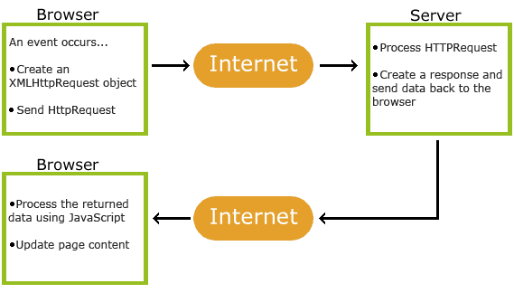
How AJAX Works
1. An event occurs … (clicking a button)
2. An XMLHttpRequest object is created by JavaScript
3. The XMLHttpRequest object sends a request to a web server
4. The server processes the request
5. The server sends a response back to the web page
6. The response is read by JavaScript
7. Proper action (like page update) is performed by JavaScript

Slide 6

Let’s make some AJAX requests

Slide 7
Fetch API
The Fetch API provides an interface for fetching resources (including across the network).
Fetch provides a generic definition of Request and Response objects.
The fetch() method takes one mandatory argument, the path to the resource you want to fetch.
It returns a Promise that resolves to the Response to that request, whether it is successful or not.

Slide 8
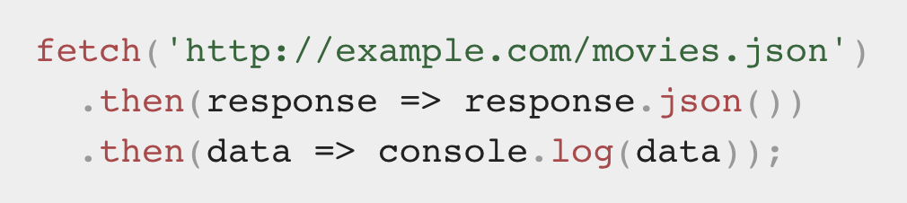
Using fetch
A basic fetch request is really simple to set up. Have a look at the following code:
Notes:
Getting a response is usually a two-stage process.
First, the promise, returned by fetch, resolves with an object of the built-in Response class as soon as the server responds with headers.
At this stage we can check HTTP status, to see whether it is successful or not, check headers, but don’t have the body yet.
Second, to get the response body, we need to use an additional method call.
Response provides multiple promise-based methods to access the body in various formats:
response.text() – read the response and return as text,
response.json() – parse the response as JSON,
response.formData() – return the response as FormData object (explained in the next chapter),
response.blob() – return the response as Blob (binary data with type),
response.arrayBuffer() – return the response as ArrayBuffer (low-level representation of binary data),
additionally, response.body is a ReadableStream object, it allows you to read the body chunk-by-chunk, we’ll see an example later.

Slide 9
Let’s make some AJAX requests using Fetch API

Slide 10
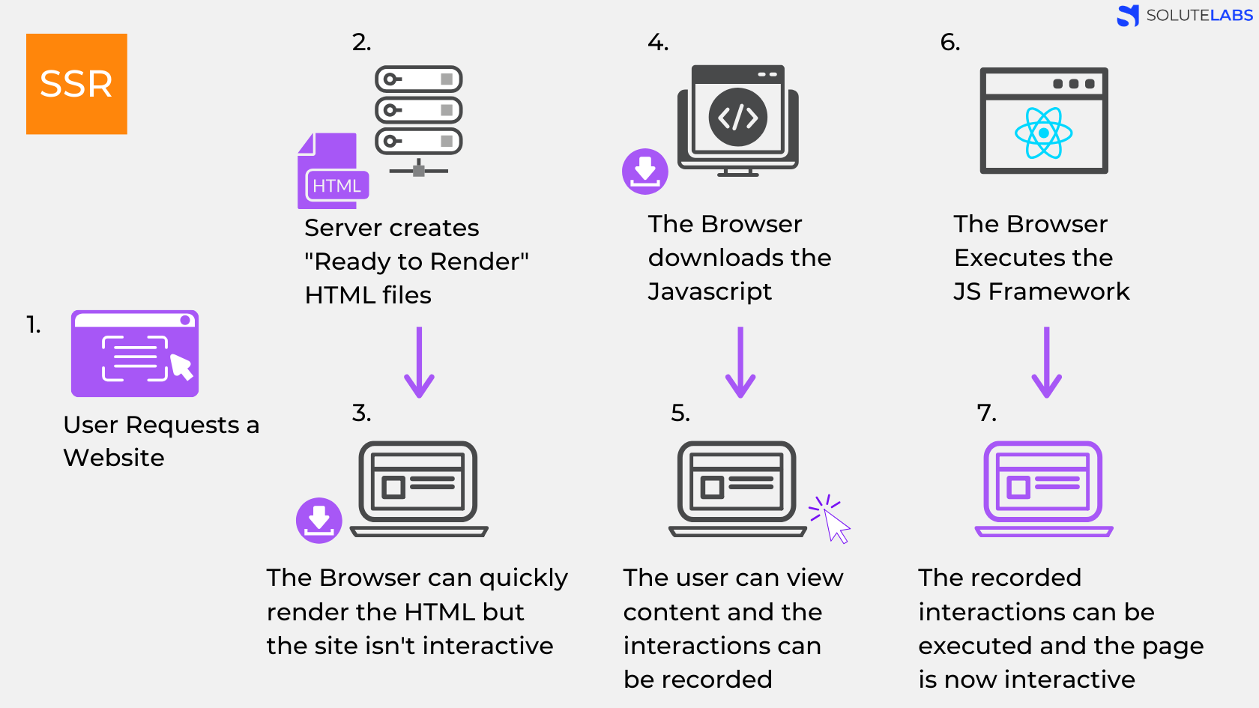

Slide 11
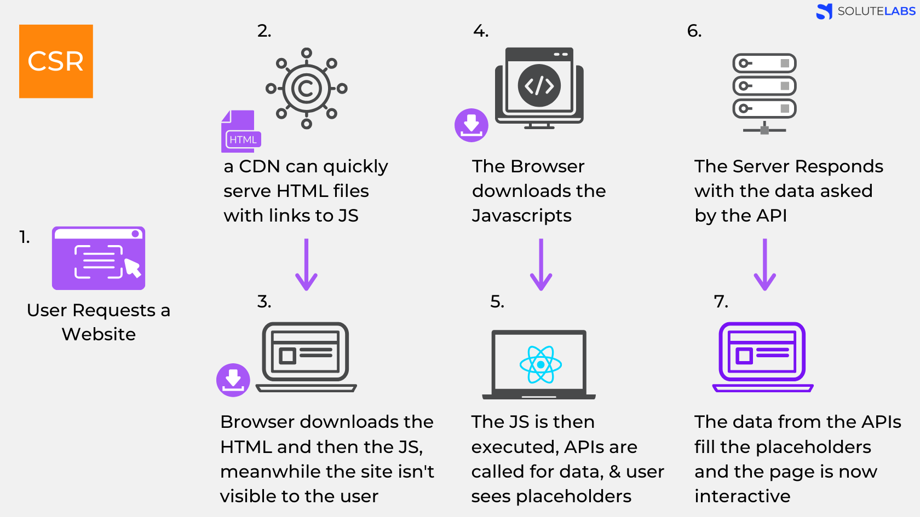

Slide 12
Server-side processing vs client-side processing
Server-side processing
Security - You don’t have to expose sensitive information (API tokens, logins etc).
"Better" client support - Some clients (IE) do not support same things as the others.
It enables pages to load faster which provides a better user experience.
SEO, social sharing etc. - How your server sends resources, that is how bots see them.
Client-side processing
Waiting times. Doing stuff on the client-side will improve your load times. But be careful not to do too many things since JS is single-threaded and heavy stuff will block your UI.
CDN - you can serve static resources (HTML, CSS, JS etc.) from CDN which will be much faster than serving them from your server app directly
Testing - It is easy to mock backend server when testing your UI.
Security - Whatever runs on the client can be fully read by the client.

Slide 13

AXIOS
Promise based HTTP client for the browser and node.js

Slide 14
Features
Make XMLHttpRequests from the browser
Make http requests from node.js
Supports the Promise API
Intercept request and response
Transform request and response data
Cancel requests
Automatic transforms for JSON data
Client side support for protecting against XSRF

Slide 15
Installation
Install using npm:
> npm install axios

Slide 16
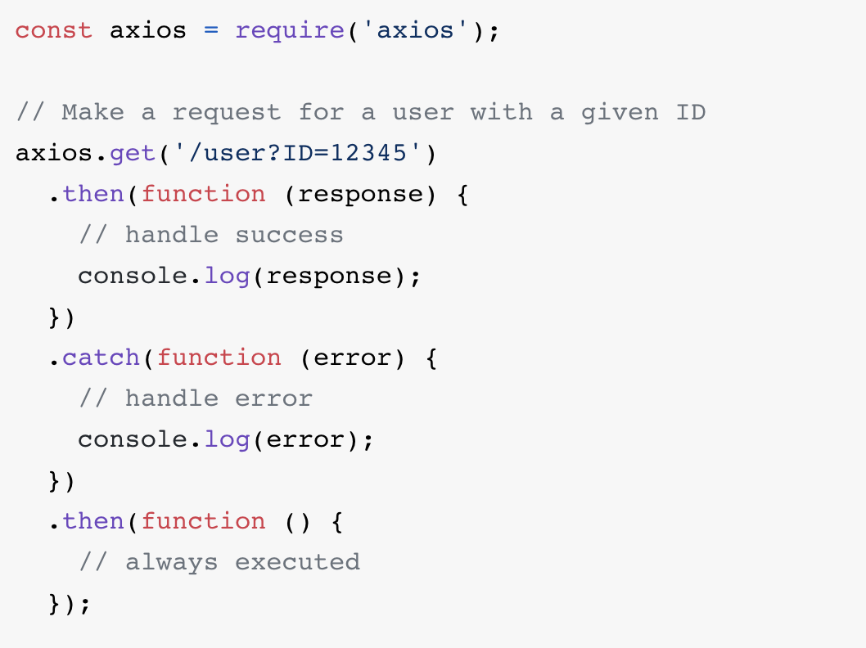
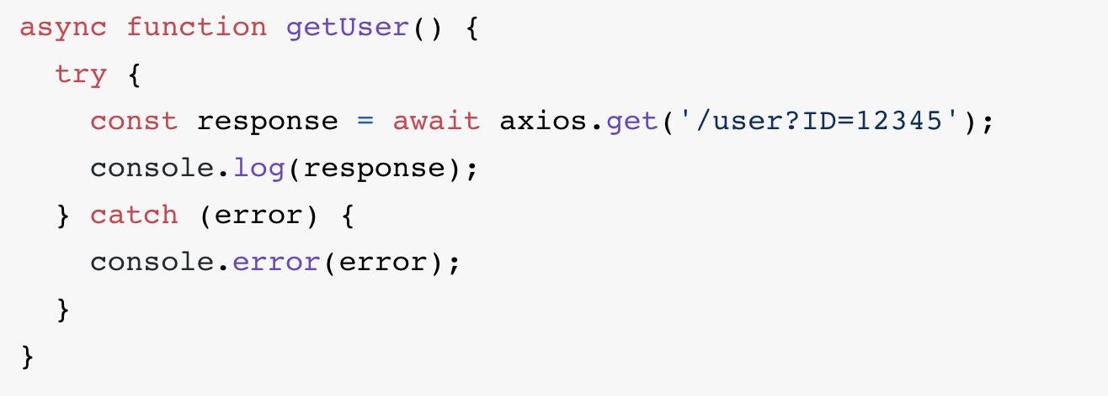
Get requests
Async & Await

Slide 17
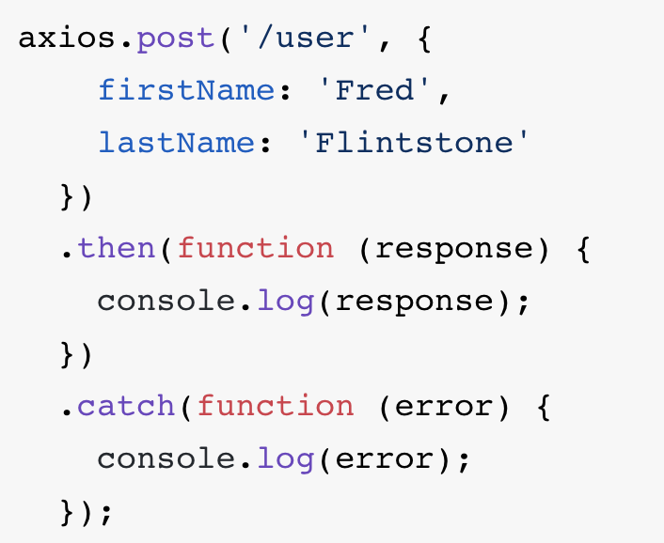
Post requests

Slide 18
Request method aliases
axios.request(config)
axios.get(url[, config])
axios.delete(url[, config])
axios.head(url[, config])
axios.options(url[, config])
axios.post(url[, data[, config]])
axios.put(url[, data[, config]])
axios.patch(url[, data[, config]])
For more detail:
https://www.npmjs.com/package/axios

Slide 19
What is Command Line Input (CLI)?
CLI is a command line program that accepts text input to execute operating system functions.
CLI is used by software developers and system administrators to configure computers, install software, and access features that are not available in the graphical interface.

Slide 20
Vue CLI
Vue CLI is a full system for rapid Vue.js development, providing:
Interactive project scaffolding via @vue/cli.
Zero config rapid prototyping via @vue/cli + @vue/cli-service-global.
A runtime dependency (@vue/cli-service) that is:
Upgradeable;
Built on top of webpack, with sensible defaults;
Configurable via in-project config file;
Extensible via plugins
A rich collection of official plugins integrating the best tools in the frontend ecosystem.
A full graphical user interface to create and manage Vue.js projects.

Slide 21

Vue router
Vue Router is the official router for Vue.js. It deeply integrates with Vue.js core to make building Single Page Applications with Vue.js a breeze.

Slide 22
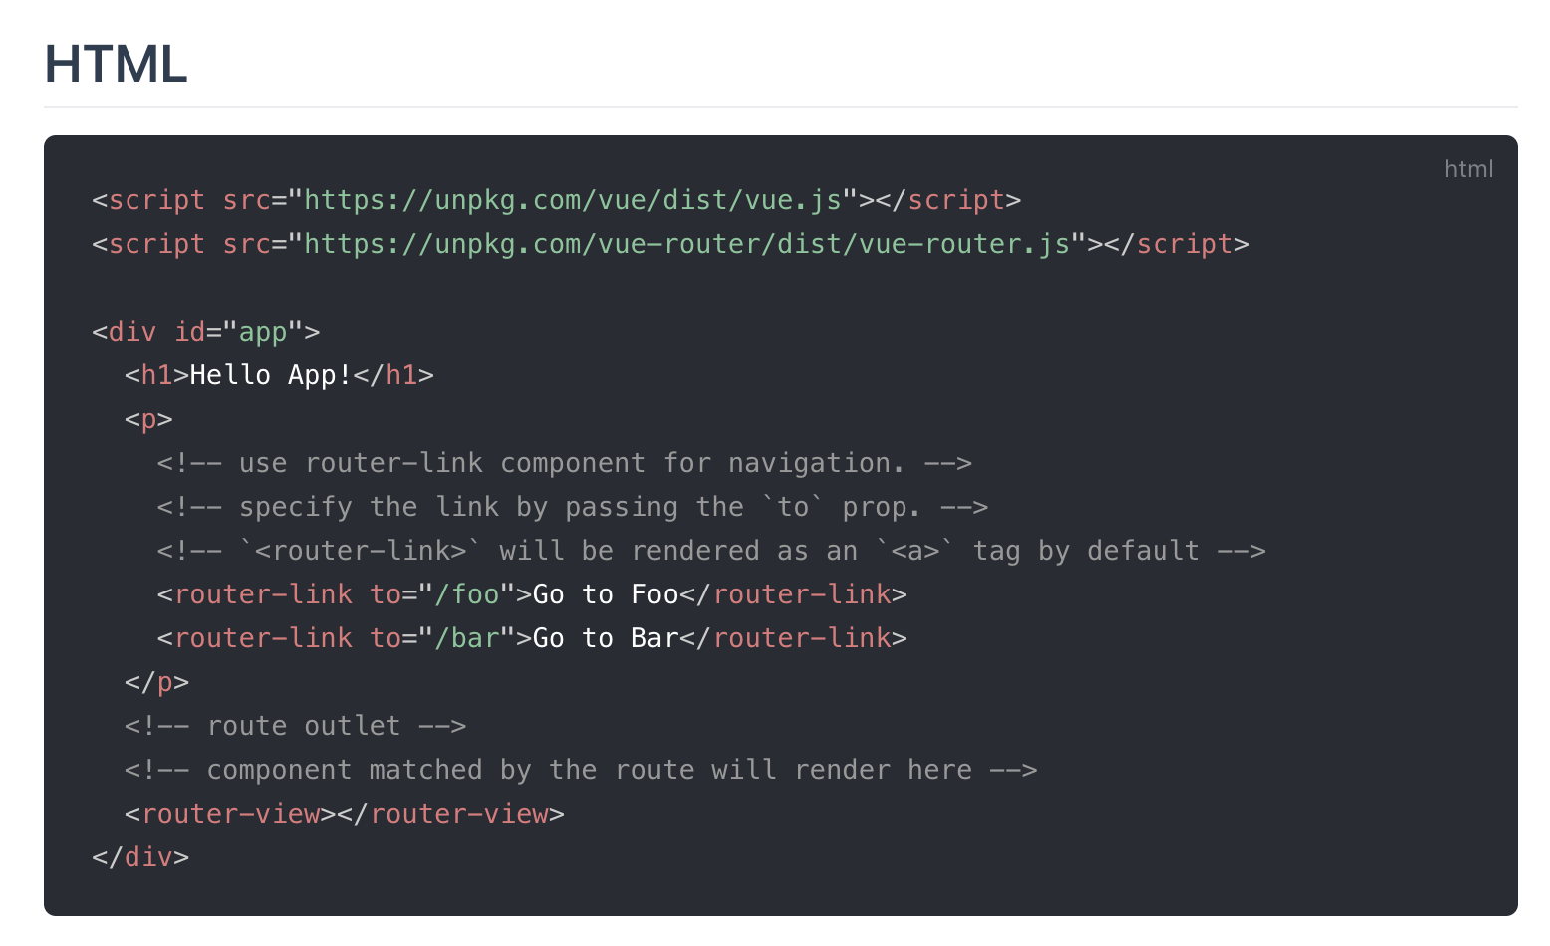

Slide 23
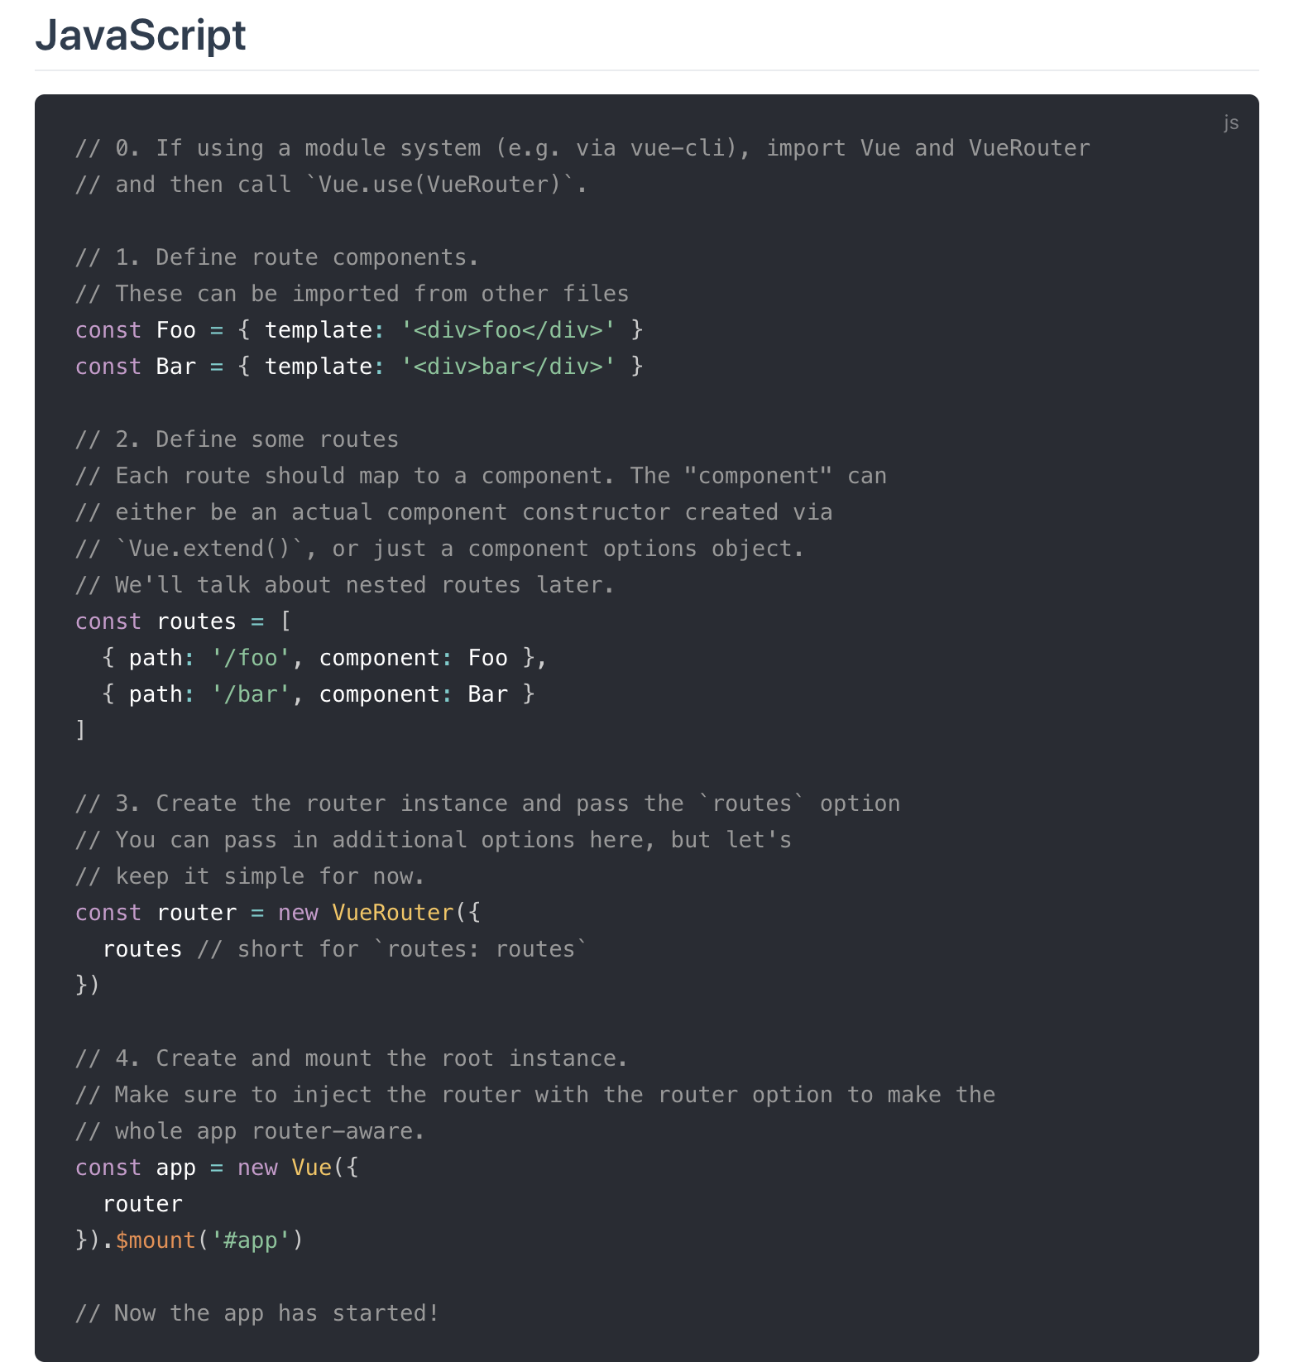

Slide 24

Let’s update the “youblog” website
Notes:
จะต้องเกริ่นเรื่อง MVC Concept

